Slide 1



Cloud Deployment
Presented by: Dr Grace U. Nneji
Dr Happy N. Monday

Slide 2
01
Deploy a Streamlit app via GitHub → Streamlit Cloud
02
Configure secrets securely in Streamlit Cloud
03
Validate the public URL and share with peers or instructor
Learning Outcomes

Slide 3
What is Cloud Deployment?
Cloud deployment refers to the process of making an application accessible on the internet through cloud platforms. In the case of our AI-powered app (Smart Energy), cloud deployment allows users, instructors, or stakeholders to:
Access the Streamlit web app from anywhere via a URL
Interact with the energy prediction model without installing Python.
Enable real-time demos, class grading, and live peer reviews.

Slide 4

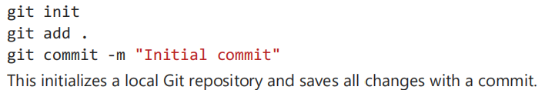
Git Repository Initialization

Slide 5
CLI Via GitHub CLI
Manual Setup

Slide 6

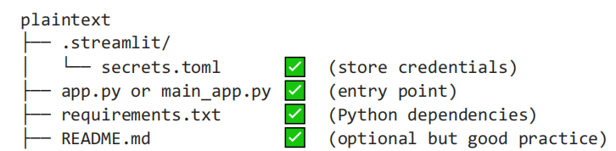
Deployment-Ready Folder Checklist
Ensure the following files exist:

Slide 7
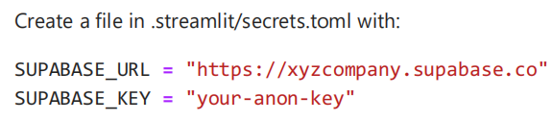
Secure Secrets with secrets.toml
You don’t want to hardcode API keys (like Supabase keys) in your scripts. Instead, use Streamlit secrets.
Local secrets.toml
secrets.toml is a secure configuration file used by Streamlit to store environment variables (like API keys).

Slide 8
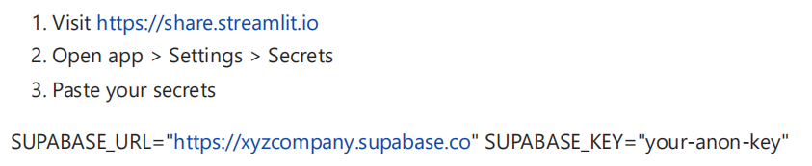
Streamlit Online Secrets Editor
Best Practice: Never expose secrets in main_app.py Always read from st.secrets.

Slide 9
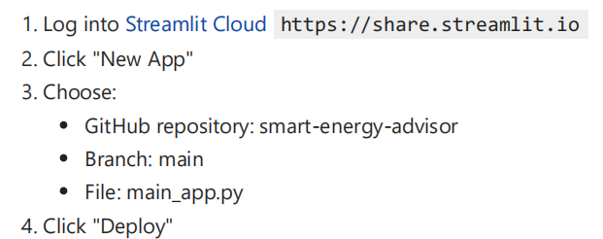
Streamlit Cloud Deployment
Streamlit Cloud provides free hosting for Streamlit apps directly from GitHub. Steps to deploy:

Slide 10
Validate the Deployment
Once the deployment completes:
Share the link via;
LinkedIn or GitHub README

Slide 11
Thank You for Listening

